Slide 1
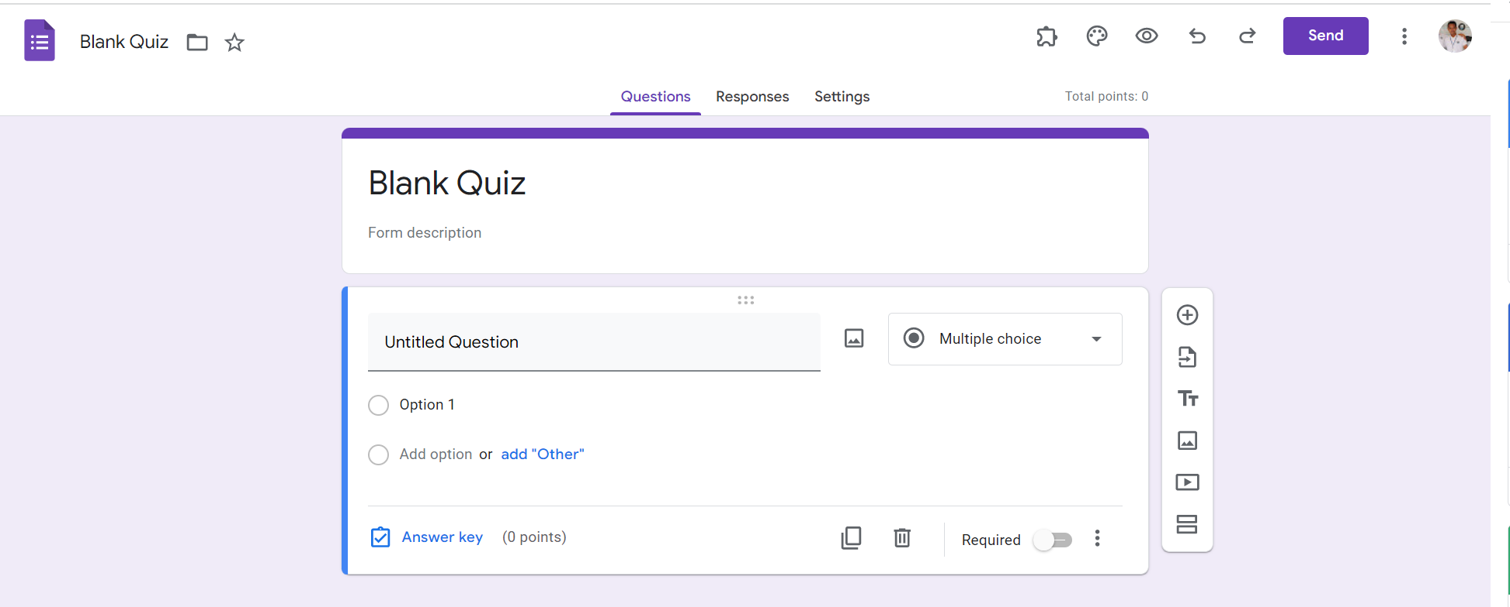
Identify root components of website below

Slide 2
Flex-direction: column;
Navagetion
Flex: 0
header
main
Flex: 1

Slide 3
Navegation | step1
Flex – direction: row;
Tool - left
Tool - right
Flex: 1
Flex: 1

Slide 4
Navegation | step1
icon
text
icon
icon
icon
icon
icon
icon
icon
btn
icon
icon
Flex – direction: row;
Justify – content: flex-end;
Flex – direction: row;
Justify – content: flex-start;

Slide 5
Hearder | step1
div1
div2
Flex – direction: row;
Justify-content: flex-end;

Slide 6
Hearder | step2
btn
btn
btn
Total
Flex – direction: row;
Justify – conten: flex-start;

Slide 7
main | step1
Flex – direction: column
Header cotent
Flex: 0
Main content
Flex: 1

Slide 8
main | step2
Flex-direction: column;
Title text
text

Slide 9
main | step3
Left-sidebar
Right-saidebar
Flex- direction: row;

Slide 10
main | step3
header
Left-text
Right - text
Flex – direction: row;
Flex-wrap: wrap;
footer

Slide 11
main | step4
Flexdirection: column;
Justify-content: center;
icon
text
icon
text
Flexdirection: column;
Text anwser
Text-answer
icon
text
text
icon
icon
turn-off&in
icon

Slide 12
main | step5
icon
Flex-direction: column;
Justify-content: space-evenly;
icon
icon
icon
icon
icon

